Slide 1

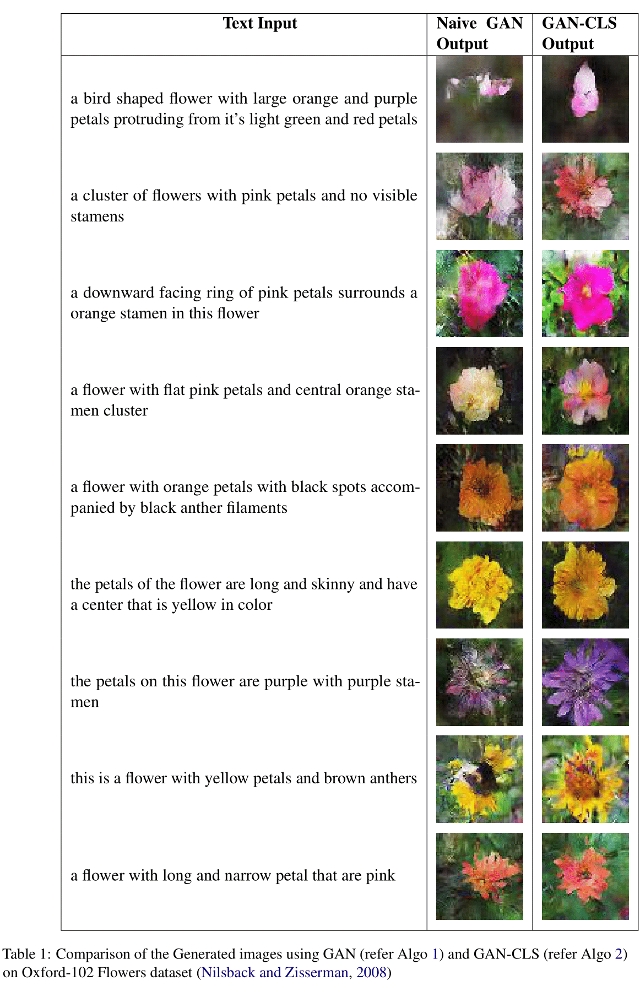
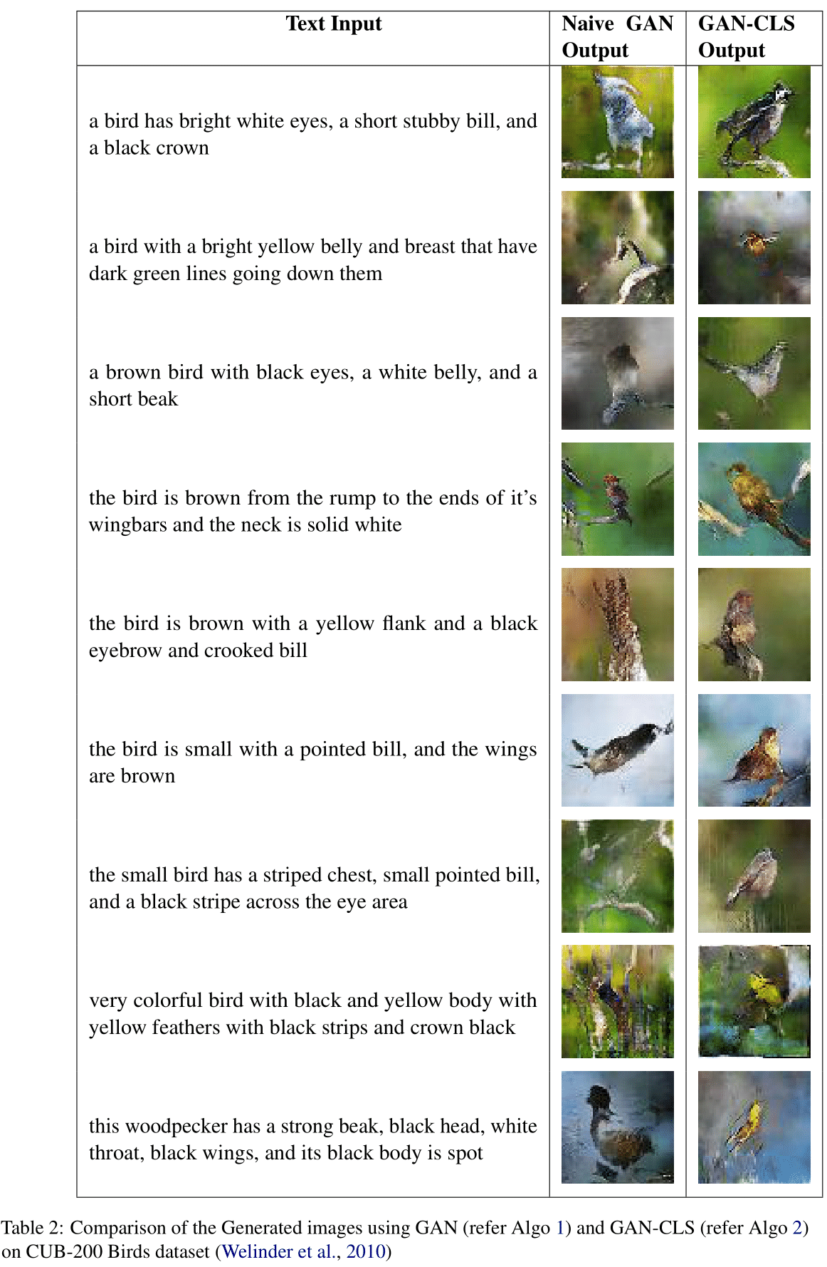
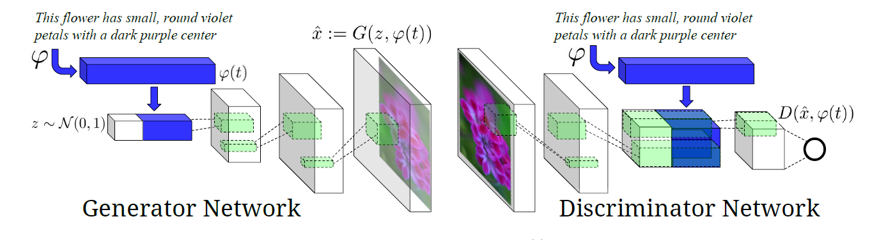
Text to Image Synthesis using Generative Adversarial Networks
Chockalingam Ravi Sundaram, Fang Zhou, Yijia Zhang
EECS595 Final Project
Abstract
Neural Network Architecture
Conclusion
The objective of our project is to train and optimize a Text to Image synthesizer model using Generative Adversarial Networks (GANs). Automatic synthesis of realistic images from text is an important and a challenging task as it involves translating visual concepts from characters to image pixels.
Our project is an implementation of the paper ”Generative Adversarial Text to Image Synthesis” by Reed et al. (Reed et al., 2016b). Our model involves a combination of RNN sequential model and Generative Adversarial Network (GAN) to map the text input to realistic images.
The Neural Network architecture for our model is shown in Fig1. This is a Generative Adversarial Network (GAN) which consists of a Generator and a Discriminator. The Generator takes the text embedding and the random noise vector as an input and generates an image corresponding to the text information. The Discriminator determines whether the image generated by the Generator is real or fake.
In this project, we developed a simple and an effective model for generating images based on detailed visual descriptions.
The text description in this dataset were very complex and sometimes long. But our model was still able to extract the important descriptors from the text input (like color, shape etc.) and produce images.
We believe that with greater computational power and deeper CNN architectures, we can produce more realistic images with higher resolution.
Datasets
1. Caltech-UCSD Birds 200 (CUB-200):
Dataset contains photos of about 200 bird species
2. Oxford-102 Flowers dataset:
Consists of images from 102 flower categories
Reference
[1] Alexey Dosovitskiy, Jost Tobias Springenberg, and Thomas Brox. 2015. Learning to generate chairs with convolutional neural networks. In Proceedings of the IEEE Conference on Computer Vision and Pattern Recognition, pages 1538–1546.
[2] Ian Goodfellow, Jean Pouget-Abadie, Mehdi Mirza, Bing Xu, David Warde-Farley, Sherjil Ozair, Aaron Courville, and Yoshua Bengio. 2014. Generative adversarial nets. In Advances in neural information processing systems, pages 2672–2680.
[3] Geoffrey E Hinton and Ruslan R Salakhutdinov. 2006. Re-ducing the dimensionality of data with neural networks.science, 313(5786):504–507.
[4] Sepp Hochreiter and J ̈urgen Schmidhuber. 1997. Long short-term memory.Neural computation, 9(8):1735–1780.
[5] Maria-Elena Nilsback and Andrew Zisserman. 2008. Auto-mated flower classification over a large number of classes.InIndian Conference on Computer Vision, Graphics andImage Processing.
[6] Scott Reed, Zeynep Akata, Honglak Lee, and Bernt Schiele.2016a. Learning deep representations of fine-grained vi-sual descriptions. InProceedings of the IEEE Conferenceon Computer Vision and Pattern Recognition, pages 49–58.
Objectives
Results
Training a model that effectively captures the important information within a text: Recent advances in sequential models show that this task can be accomplished by training a RNN based language model.
Translating the text information to image: This will be accomplished by a Conditional Generative Adversarial Neural Network
Acknowledgment
We would like to acknowledge our course instructor Prof. Joyce Chai and the support of our GSI Cristian Paul Bara for their continued support. We would also like to thank the developers of PyTorch framework. We also like to thank Google Colab services for providing us with free GPU credits to run our codes.
Figure 1, the overall structure

